Slide 1
Predicting Ion Channels Opening
Jarod Carroll

Slide 2
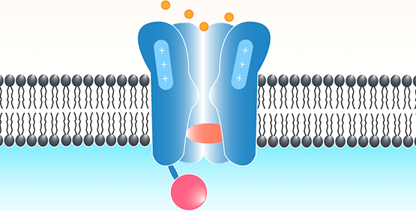
The Ion Channel
Allows ions to pass through it
Many different flavors of ion channels
Can change between states (e.g. open and closed)
Able to change the voltage of cells
Responsible for almost all electrical activity in the body

Slide 3
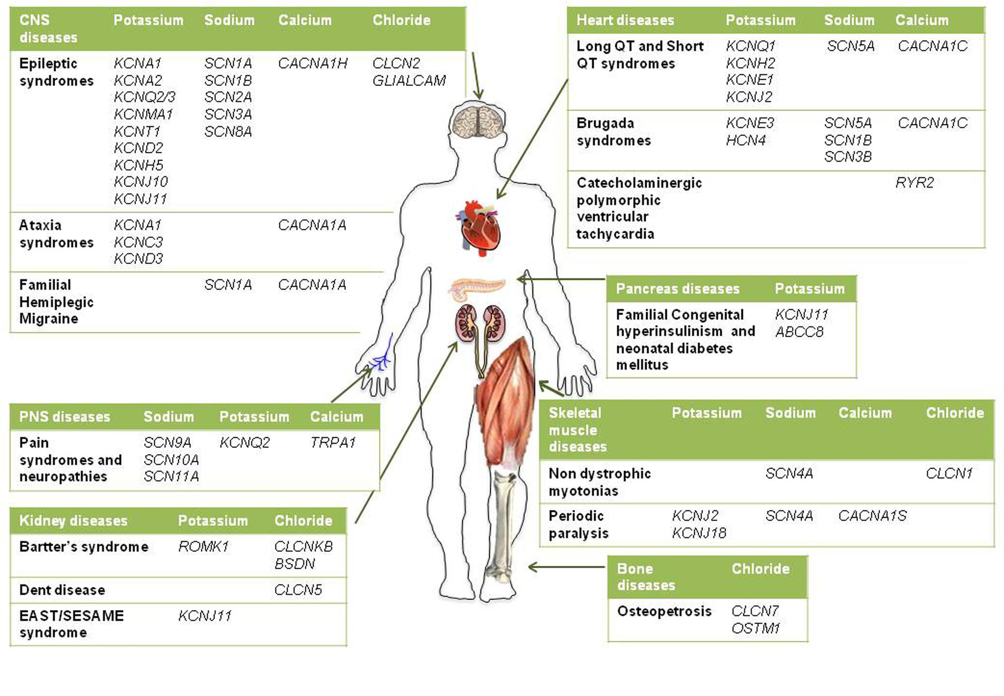
Channelopathies
Ion channels don’t function properly
Improper voltage on cells
Leads to diseases like epilepsy, cystic fibrosis, heart arrhythmia
Almost every system in the body involves ion channels.
To study the mechanics of these diseases the Ion channel needs to be studied. But how?

Slide 4
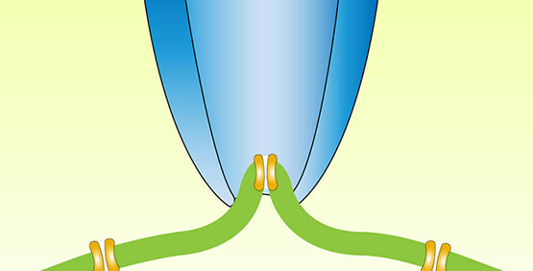
Patch Clamp
Allows for the capture and recording of a patch of the cell membrane.
Ideally this would get one or two channels but can get many channels.
Usually multiple channel data must be discarded. This is a huge time/labor waste

Slide 5
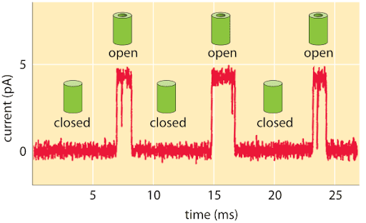
Goal and Why it’s important
Be able to predict the number of open channels from patch clamp data.
Allows for the study of ion channels.
Being able to interpret multichannel data can increase the ability to study ion channels.

Slide 6
Process
Get the data
Process and transform it
Break the data into its different waveforms
Train a model
Transform the test data
Make predictions and get a score from Kaggle

Slide 7
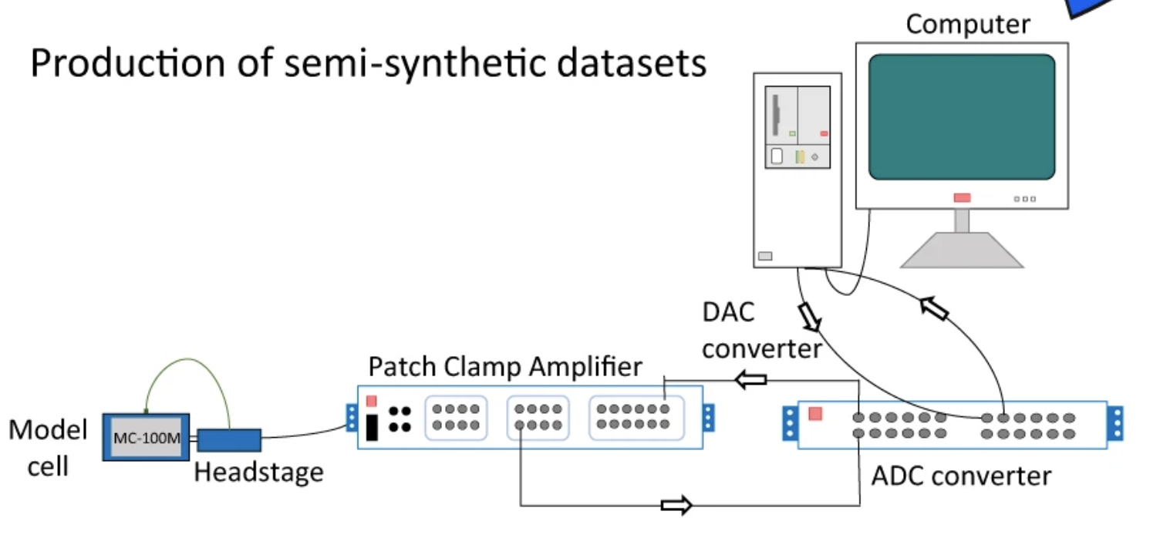
Where does the Data come from?
Kaggle competition by University of Liverpool.
Generated by a computer and played through normal patch clamp equipment.
Real world noise and drift added.
Indistinguishable from real data.
10 batches
50 seconds per batch
10 kHz data (10k points per s)

Slide 8
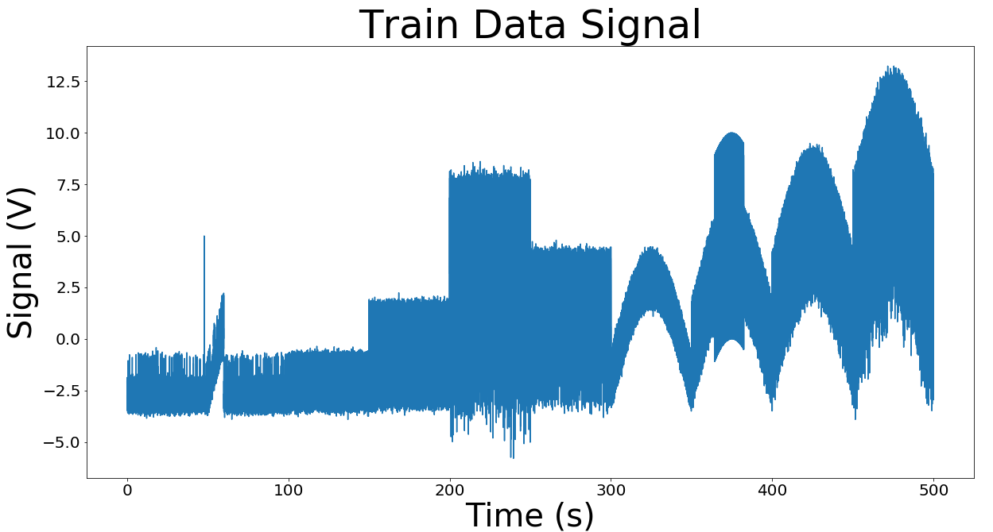
Inspecting the data

Slide 9
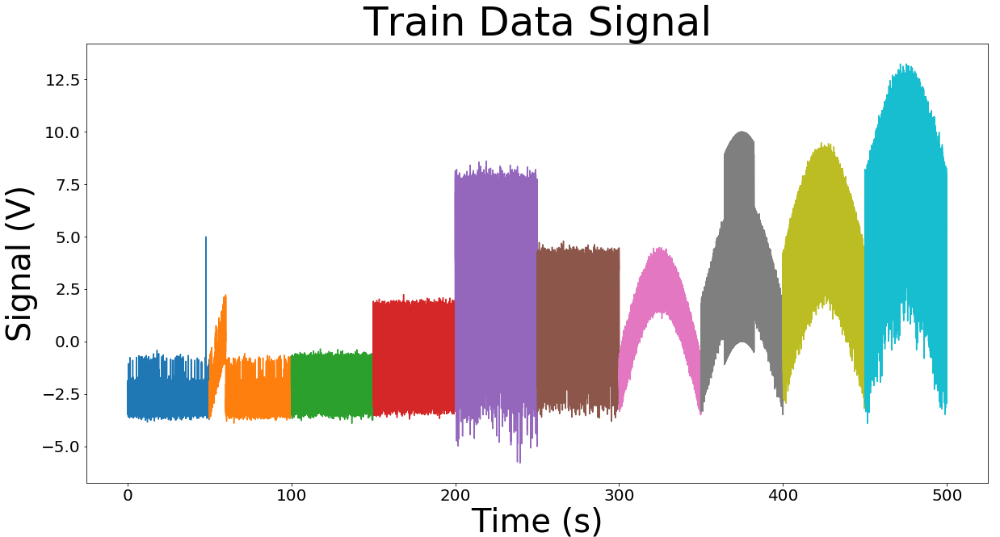
10 Sets of Data

Slide 10
Drift
Linear Drift
Parabolic Drifts

Slide 11
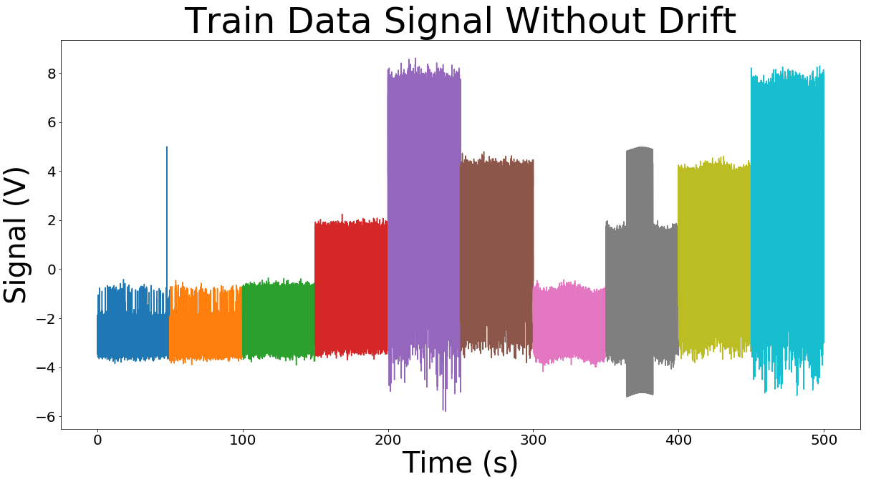
Remove Drifts with Functions

Slide 12
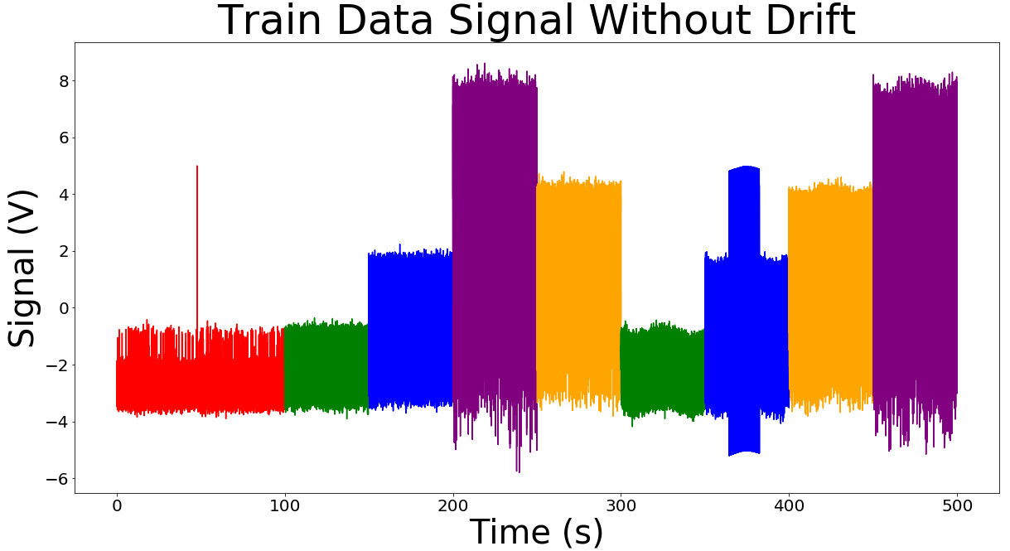
Different Waveforms

Slide 13
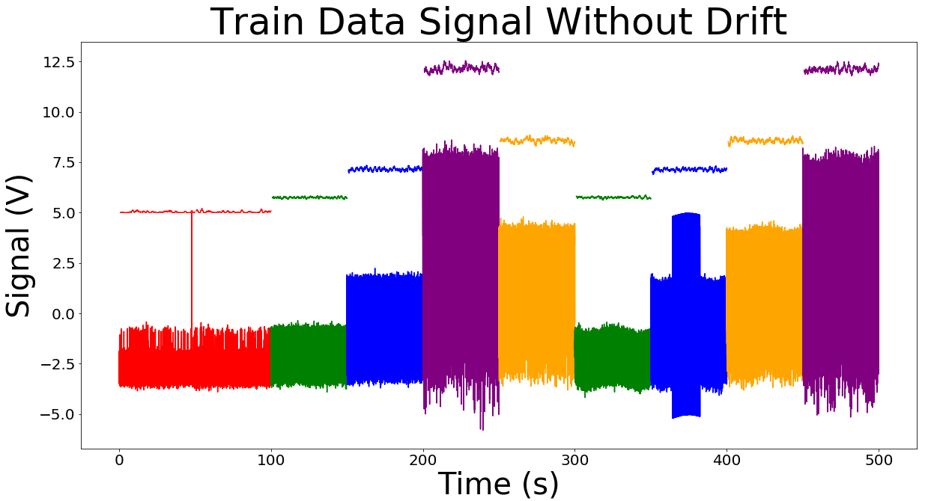
Different Waveforms
10
5
3
1f
1s

Slide 14
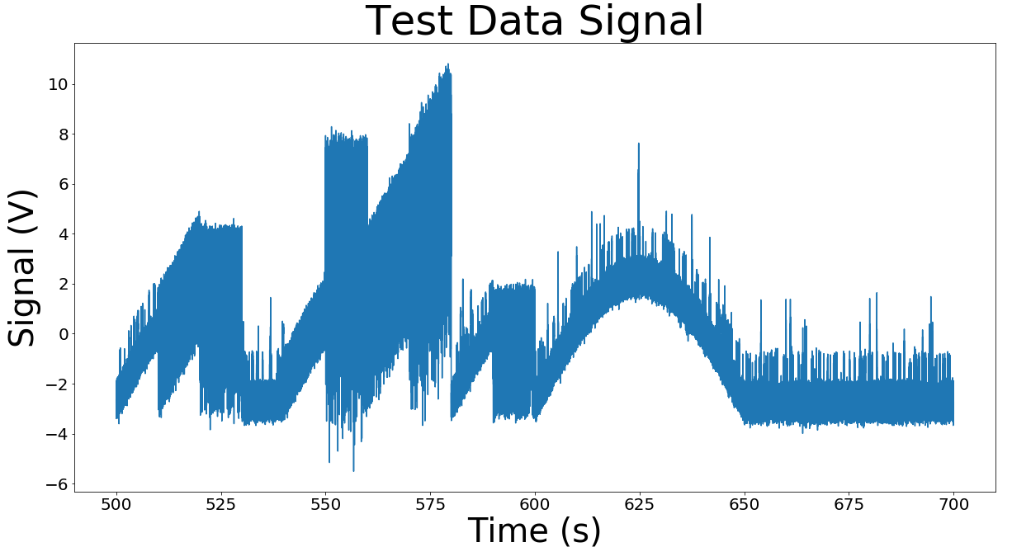
Test Data Drift

Slide 15
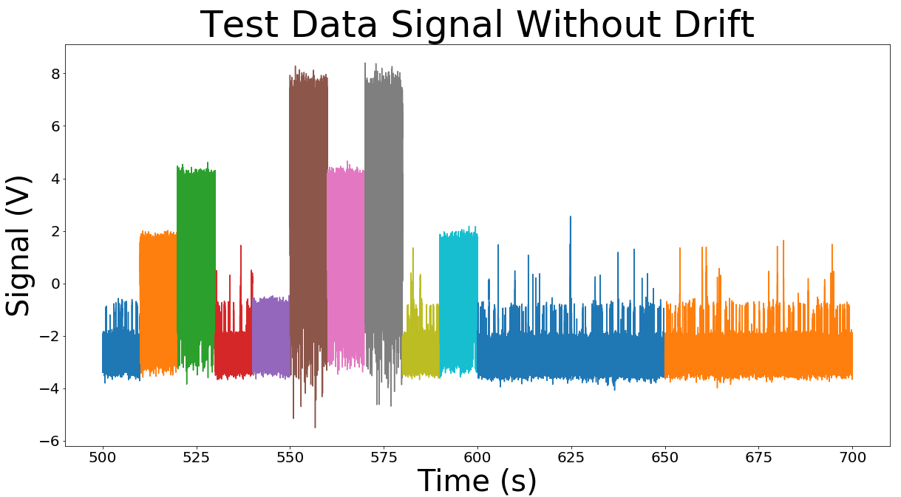
Test Data Drift

Slide 16
5 Models
Make a model for each waveform after the drifts are removed
Apply the the model that corresponds to the test waveform
Submit on Kaggle to get a macro F1 score
Macro F1
  Average of the F1 score for each class (a class is each number of ion channels open [0,10])
  Example of f1 for class 9
    False positive: guessing class 9 when it is not actually class 9
    False negative: guessing not class 9 when it is actually class 9
  Do this for all classes and take the unweighted average

Slide 17
Poor models
Without breaking up the data and without removing the drift:
  Dummy Model (guess majority class)
    F1: 0.160
  Random Forest
    F1: 0.210
After breaking up the data but leaving in the drifts
  Dummy Model
    F1: 0.278
  Neural Network
    F1: 0.630

Slide 18
Better Models
Remove drift by using each waveforms rolling mean
  Random Forest
    F1: 0.86
  Neural Network
    F1: 0.88
Remove Drift Using function (better)
  Random Forest
    F1: 0.92
  Neural Network
    F1: 0.92

Slide 19
Best Models so far
Sliding Window
Each point is the signal 10 time points before to 10 time points after
A neural network was trained using this sliding window data
0.938

Slide 20
What Next?
Optimize the model more.
Think of new ways to feature engineer and to make models.
Try to get an F1 score above 0.940

Slide 21
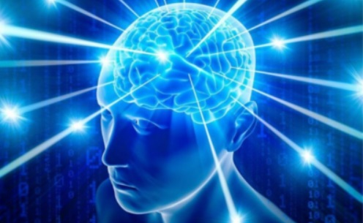
Thank you!
https://github.com/Jarodc33
www.linkedin.com/in/jarod-carroll-762a361a8

